Slide 1

Lecture 1
Introduction To
Software Entrepreneurship

Slide 2
Learning Outcomes of the Course
UECS3393 Software Entrepreneurshi
▪▪ After completing this unit, students will be able to:
Decide on viability of software technology proposed in retrospect of a business model or suggestion
Present and defend a basic business plan, for proposal of software business ideas or enhancement of existing business
Peruse software business case studies for analysis or criticism of a proposal
Analyze feasibility of a business plan including technology application and the establishment of a basic software business organization
Identify the essentials of the marketing and selling disruptive software products to mainstream

Slide 3
Software Entrepreneurship …a definition
UECS3393 Software Entrepreneurship
▪▪ Software Entrepreneur = Software + Entrepreneur
An entrepreneur who uses different set of cutting-edge developing technologies and/or strategies than other business start-ups to develop new business models
The development of software, a digital “soft” good, involves different business models, product strategy, people management, and development plan compared to the traditional manufacturing and service industries
whose business involves software and IT technology
2
UTAR – FES DIECS |

Slide 4
What Is an Entrepreneur?
UECS3393 Software Entrepreneurship
▪▪ Employees — earn their livings working for someone else’s business.
▪▪ Entrepreneurs — earn their livings starting, owning, and working for their own businesses.

Slide 5
Self Employment vs Wage Employment
UECS3393 Software Entrepreneurship
Self Employment | Wage Employment
Work for profit | Work for wages
Make a fortune | Make a living
You become rich | You make others rich
Residual income is created | No residual income
Unlimited opportunity for progress | Limited opportunity for progress
Your own boss | Somebody is your boss
Reduce unemployment | Increase unemployment

Slide 6
Self Employment vs Wage Employment
UECS3393 Software Entrepreneurship
Self Employment | Wage Employment
Multiplier effect | No Multiplier effect
Create wealth for generations | No wealth for generations
Can create extra ordinary lifestyle | Normal lifestyle
Reduce rural urban migration | Increase rural urban migration
Create a economy of entrepreneurs | No real economy is created

Slide 7
Why Be an Entrepreneur?
UECS3393 Software Entrepreneurship
▪▪ Reasons To Become One:
Control over time
Fulfillment
Creation/Ownership
Control over Compensation
salary
wage
dividend
commission
Control over Working Conditions

Slide 8
Costs and Benefits of Entrepreneurship
UECS3393 Software Entrepreneurship
Costs Benefits
▪▪ Business failure
▪▪ Obstacles
▪▪ Loneliness
▪▪ Financial Insecurity
▪▪ Long Hours/Hard Work
▪▪ Personal sacrifices
▪▪ Burden of responsibility
▪▪ Little margin for error
▪▪ Independence
▪▪ Satisfaction
▪▪ Financial Reward
▪▪ Self-Esteem
▪▪ Autonomy
▪▪ Challenge of a start-up
▪▪ Financial control

Slide 9
What Does An Entrepreneurs Do?
UECS3393 Software Entrepreneurship
▪▪ Everything starts from a BUSINESS IDEA
▪▪ However, idea is not enough.
▪▪ Necessary to :
ensure the technology to make the idea work or
can be developed at a reasonable cost within a reasonable time
▪▪ Next, receive feedback ( +ve, -ve, constructive etc.) on what he/ she thinks it is a “workable idea”
▪▪ Writes his/her business plan
▪▪ Get financing
▪▪ Develop
▪▪ Marketing

Slide 10
Why is Malaysia in Dire Need of Software Entrepreneurs?
UECS3393 Software Entrepreneurship
▪▪ To sustain the growth of the economy
▪▪ Wealth creation
▪▪ Jobs creation
▪▪ Entrepreneurs
Comfortable With Technology
strong passion to learn and understand technologies.
They were frustrated with the way things were, and they wanted to make some changes.
To make changes, they had to have skills.
“Must understand the problem in detail, in order to solve the problem”

Slide 11
Blue Ocean Strategy
UECS3393 Software Entrepreneurship
▪▪ Red Ocean vs Blue Ocean
Red Ocean | Blue Ocean
Industries that are already in existence Limited demand Firms compete to capture more market share Limited room for growth Limited outlook for profit growth Most strategy is developed to compete in Red Oceans Multiplier effect | Are untapped market space Unlimited potential for growth in demand Room for highly profitable growth Largely uncharted Very little research into creating these markets
Now, Malaysian online store | 3-5 years ago, Malaysian online store
Now, Budget Airlines | 4-8 years ago, Budget Airlines
YOUR DUTY TO “LEAD” in red ocean | YOUR DUTY TO “CREATE” opportunity

Slide 12
Red Oceans vs Blue Oceans – VALUE INNOVATION
UECS3393 Software Entrepreneurship
Red Ocean | Blue Ocean
Compete in existing market space Beat the competition Exploit existing demand Make the value-cost trade-off | Create uncontested market space Make the competition irrelevant Create and capture new demand Break the value-cost trade-off
UTAR – FES DIECS |

Slide 13
The Concept of Business and the Concept of Profit
UECS3393 Software Entrepreneurship
▪▪ Business
organization that provides goods or services to earn profits
▪▪ Profits
difference between a business’s revenues and its expenses
▪▪ Businesses produce most of the goods and services we consume. They employ most working people.
▪▪ They create most new innovations and provide a vast range of opportunities for new businesses.
▪▪ Many businesses support charities and provide community leadership.
UTAR – FES DIECS |

Slide 14
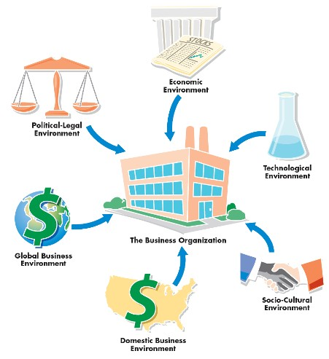
Dimensions of the External Environment (Business Model)
UECS3393 Software Entrepreneurship
UTAR – FES DIECS |

